Slide 1




Tasty Bites Restaurant Sales Analysis
Business Performance Dashboard and Strategic Insights
Reporting Period: July 2024 -February 2025
Power BI
MySQL
Analytics
Presented By: Sonia Nzau | Role: Data Analyst Candidate | July 2026

Slide 2



Project Overview
Scope, data foundation, and analytical approach behind this report
OBJECTIVE
RECORDS ANALYZED
Analyze restaurant sales data to identify trends, customer behavior, and operational insights that support data-driven business decisions.
250
complete daily transactions
DATASET SUMMARY
250 complete daily sales records across an 8-month trading window
Fields tracked: daily sales, customers served, feedback score, day of week, weather, promotions, and top-selling menu item
March 2025 (7 days) excluded from some trend analysis — the month is still in progress and would distort monthly comparisons
ANALYSIS PERIOD
8 Months
Jul 2024 – Feb 2025
METHODOLOGY
Sales transactions were consolidated in Excel, modeled and queried in MySQL, then visualized in Power BI to surface trend, correlation, and segment-level patterns used throughout this deck.
TOOLS USED
Excel · MySQL
Power BI
Tasty Bites | Sales Performance Analysis
2

Slide 3




Sales & Customer Trends
Power BI Desktop
Monthly Sales Performance, July 2024 – February 2025 (March excluded — incomplete)
Sum of Total_Sales_GHS by Year and Month
GH₵190K
Key Insights
Sales increased steadily from GH¢129K in July to GH¢189K in October.
October recorded the highest monthly revenue.
Sales declined after October but remained relatively stable through January.
February closed at GH¢162K, indicating a slowdown that may require further investigation.
GH₵189K
GH₵180K
GH₵176K
GH₵173K
Sum of Total_Sales_GHS
GH₵170K
GH₵168K
GH₵167K
GH₵160K
GH₵162K
GH₵152K
GH₵150K
GH₵140K GH₵130K
GH₵129K
GH₵120K
Jul 2024
Aug 2024
Sep 2024
Oct 2024
Nov 2024
Dec 2024
Jan 2025
Feb 2025
Year
EXECUTIVE INSIGHTS
PEAK MONTH
LOWEST MONTH
OVERALL TREND
CUSTOMER PATTERN
Date
7/1/2024
V
October 2024
July 2024
+31% growth
Tracks sales closely
 2/28/2025 
GHS 189,000 in sales
GHS 128,700 in sales
Jul → Oct 2024, then plateaus
traffic is the primary sales lever

Slide 4
Sales & Customer Trends
Monthly Sales Performance, July 2024 – February 2025 (March excluded — incomplete)
Key Insights
Customer traffic increased steadily from 3,123 customers in July to 4,740 customers in October.
October recorded the highest customer volume during the reporting period.
Customer traffic declined after October but remained relatively stable through January.
February closed with 3,737 customers, reflecting a noticeable reduction in restaurant visits.
The customer trend closely mirrors the monthly sales trend, indicating that customer traffic is a major driver of revenue.
Sum of Customers_Served by Year and Month
Power BI Desktop
4740
4500
4276
4301
Sum of Customers_Served
4183
4204
4000
3737
3737
3500
3123
3000
Jul 2024
Aug 2024
Sep 2024
Oct 2024
Year
Nov 2024
Dec 2024
Jan 2025
Feb 2025
EXECUTIVE INSIGHTS
PEAK MONTH
LOWEST MONTH
OVERALL TREND
CUSTOMER PATTERN
Date
7/1/2024
V
October 2024
July 2024
+31% growth
Tracks sales closely
 2/28/2025 
GHS 128,700 in sales
GHS 189,000 in sales
Jul → Oct 2024, then plateaus
traffic is the primary sales lever

Slide 5

Operational Performance Drivers
Three external and operational factors that shift daily performance
Busiest Days
Promotion Impact
Customers Served by Day
Average Sales: Promotion vs No Promotion
Power BI Desktop
Power BI Desktop
GH₵6K
GH₵5.7K
Sunday
6.4K
GH₵5.2K
GH₵5K
Saturday
6.0K
Average of Total_Sales_GHS
Friday
5.2K
GH₵4K
Day
Wednesday
4.5K
GH₵3K
Thursday
4.1K
GH₵2K
Tuesday
3.8K
GH₵1K
Monday
3.5K
0K
2K 4K
Sum of Customers_Served
6K
GH₵0K
True
False
Promotion_Active
📅 Peak Traffic | 🏷️ Promotion Impact | 📈 Business Insight
Sunday recorded the highest customer traffic (6.4K customers), making weekends the busiest trading period. | Promotional campaigns increased average daily sales from GH¢5.2K to GH¢5.7K, showing a positive impact on revenue. | Customer traffic and promotions are key drivers of restaurant performance and should be prioritized in operational planning.

Slide 6

Operational Performance Drivers
Three external and operational factors that shift daily performance
Weather Impact
Executive Insights
🌧 Highest Sales Rainy Weather GH¢5.9K average daily sales
📊 Sales Difference +18% Higher Rainy days generated approximately 18% more sales than sunny days.
💼 Business Insight Weather Influences Demand Customer purchasing patterns vary across weather conditions.
Average of Total_Sales_GHS by Weather
Power BI Desktop
GH₵6K
GH₵5.9K
GH₵5.5K
GH₵5K
GH₵5.0K
Average of Total_Sales_GHS
GH₵4K
GH₵3K
GH₵2K
GH₵1K
GH₵0K
Rainy
Cloudy
Weather
Sunny

Slide 7
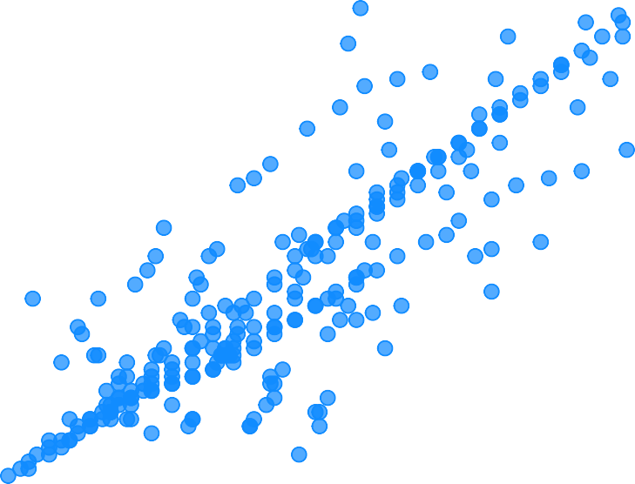
Customer Behaviour and Sales Relationships
Understanding the key factors influencing restaurant revenue
Relationship Between Customers Served and Total Sales
GH₵10K
Average of Customer_Feedback_Score and Average of Total_Sales_GHS by Record_ID
GH₵10K
Power BI Desktop
Power BI Desktop
GH₵8K
Average of Total_Sales_GHS
GH₵8K
Total_Sales_GHS
GH₵6K
GH₵6K
GH₵4K
GH₵4K
GH₵2K
50
100
150
Customers_Served
200
250
GH₵2K
3.6
3.8
4.0 4.2 4.4 4.6
Average of Customer_Feedback_Score
4.8
5.0
👥 Customer Volume | ⭐ Customer Satisfaction | 💼 Business Insight
Strong Positive Relationship Higher customer traffic consistently resulted in higher sales revenue. | Positive Association Higher customer feedback scores were generally associated with increased sales. | Revenue Growth Driver Growing customer traffic while maintaining excellent service quality supports sustainable revenue growth.

Slide 8
Menu Performance
Which dishes are earning their place on the menu
Most Popular Menu Items
Power BI Desktop
TOP SELLING MENU ITEM
Jollof & Chicken
Jollof & Chicken
72
72 orders
28.8% Menu share
Fried Rice & Beef
36
Top_Menu_Item
Grilled Tilapia
36
WHY THIS MATTERS
Waakye
36
Jollof & Chicken is the restaurant's highest-demand menu item, making it a key driver of sales. Its consistent popularity supports demand forecasting, inventory planning, and purchasing decisions while creating opportunities for targeted promotions.
Banku & Fish
35
Fufu & Light Soup
35
RECOMMENDED ACTION
0
20
40
Count of Top_Menu_Item
60
Leverage Jollof & Chicken in combo meals and promotional bundles to increase average order value while encouraging sales of lower-performing menu items.
Tasty Bites | Sales Performance Analysis
6

Slide 9
Business Recommendations
Three priority actions to convert insight into revenue
1
2
3
Increase Promotions During Low Seasons
Optimize Weekend Operations
Bundle the Menu Around Jollof and Chicken
Increase promotions during January and February to stimulate customer demand during slower trading periods.
Align staffing schedules and inventory planning with higher weekend customer demand to ensure efficient service during peak trading periods.
Leverage the popularity of Jollof & Chicken (28.8% menu share) by offering combo meals and promotional bundles with complementary menu items.
EXPECTED IMPACT
EXPECTED IMPACT
EXPECTED IMPACT
Expanding promotions during slower periods can increase customer traffic and support more consistent monthly revenue.
Optimizes staffing and inventory planning during peak demand periods, helping maintain service quality and maximize revenue opportunities.
Encourages cross-selling opportunities, increases average order value, and improves the visibility of lower-performing menu items.
Key Takeaway: Customer traffic, promotions, operational planning, and menu optimization are the primary drivers of sales performance at Tasty Bites Restaurant.

Slide 10





Executive Summary
Four Critical Insights from the Tasty Bites Sales Analysis
Sales Trend
Customers
Sales increased steadily to a peak in October 2024 before moderating in the following months, highlighting opportunities for targeted seasonal promotions..
Customer traffic showed a strong positive relationship with revenue, making customer acquisition and retention key business priorities.
Promotions
Customer Satisfaction
Promotional campaigns were associated with higher average daily sales, demonstrating their value as a revenue growth strategy.
Higher customer satisfaction scores were associated with stronger sales performance, reinforcing the importance of delivering a positive customer experience.
Executive Conclusion
The analysis demonstrates that customer traffic, promotional strategies, operational planning, and menu optimization are the primary drivers of sales performance at Tasty Bites Restaurant. Implementing these recommendations can support sustainable business growth and improved operational efficiency.
Thank You
Questions & Discussion

